Slide 1

WV DOT Scanning Project
Presented By: WV GIS Technical Center
November 20, 2025

Slide 2

Table of Contents
01
02
03
Project Overview
Project Operation
Project Statistics
Overview of our system design and application.
How we process plans at the WVGISTC.
Current statistics for the project.

Slide 3

01
Project Overview

Slide 4
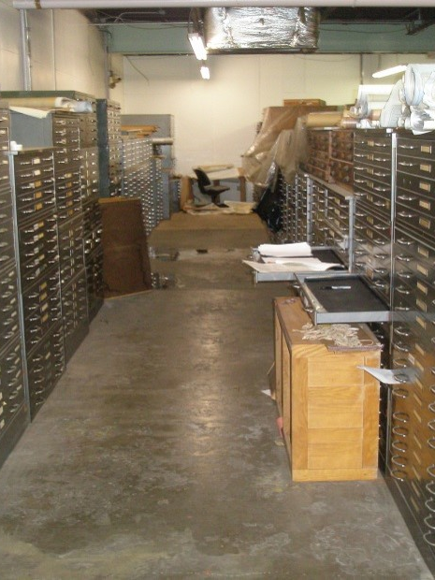
Project Goals
Improved Management and Archival System
Electronic database manages plan sets and associated documents.
Eliminates lost drawings, misfiled drawings, and deterioration of drawings.
Consolidates record plan sets in one location in a digital database.

Slide 5
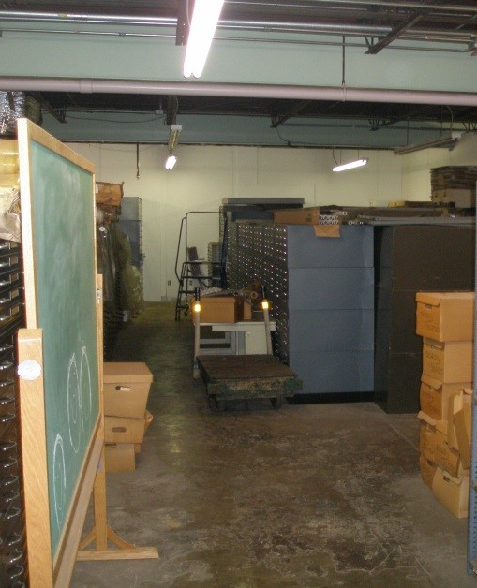
Project Goals
Faster and Easier Access to Drawings
Accessible by anyone, at any time, from anywhere.
Improved document accessibility for both internal and external users.

Slide 6
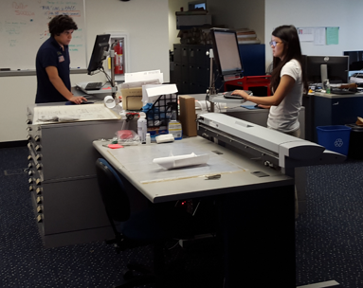
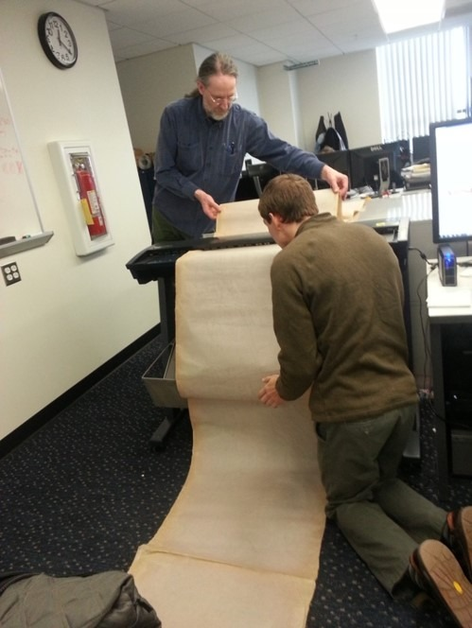
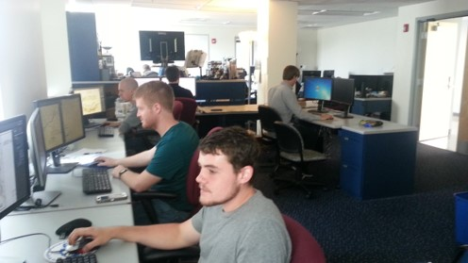

Slide 7
System Design
Web Application
Application
(HTML/CSS/Javascript)
(ArcGIS Javascript API)
Internet
Tablet Application
ArcGIS Server
Mobile Application
Microsoft SQL Server & Enterprise ArcGIS Geodatabase
SQL Server Standard
(DBMS)

Slide 8
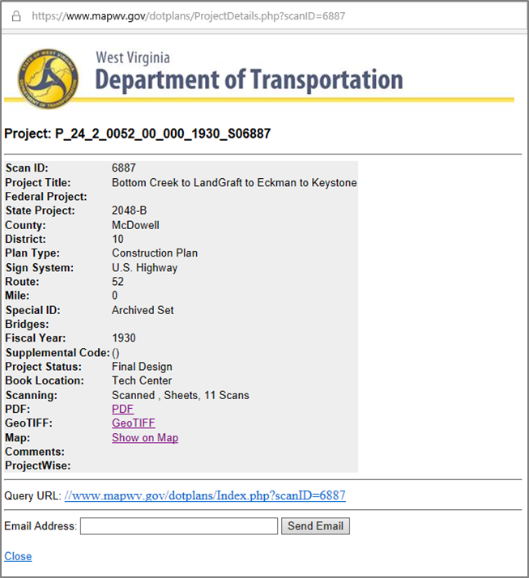
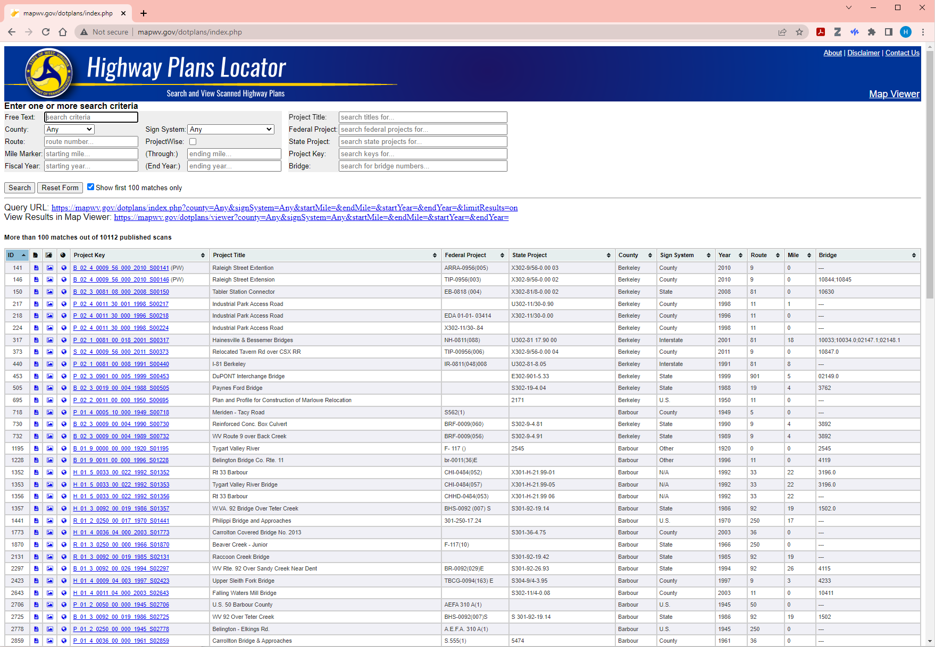
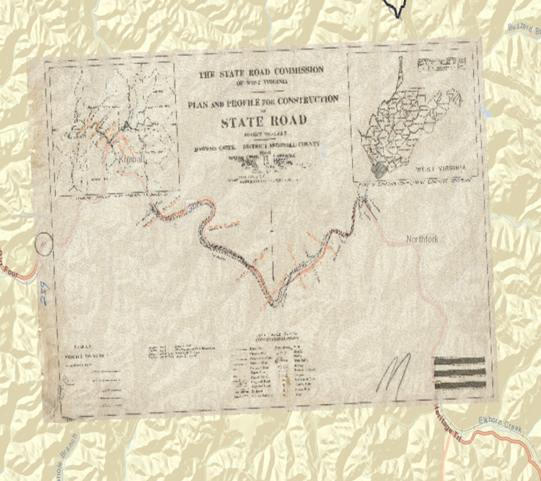
Online Highway Plan Locator
http://mapwv.gov/dotplans/

Slide 9
02
Project Operation

Slide 10





Operational Flow
Publishing
Preparation
Quality Control
Georeferencing
Building PDF
Image Processing
Scanning

Slide 11
Key Software
Adobe Photoshop
Adobe Acrobat
ArcGIS Pro
Network Drive
Script Based
Microsoft Access

Slide 12
Project Book Preparation
Unpacking
Sorting
File Naming
Plans given by the DOT are moved to the naming pile.
Each folder is checked for organization and sorted.
Plan information is entered into the Database.

Slide 13
Project Book Scanning
04
Scanner is cleaned and set up.
The original scans are relocated to the network drive.
01
03
Each page is cleaned and repaired as needed.
02
Each sheet is scanned and checked for errors.

Slide 14
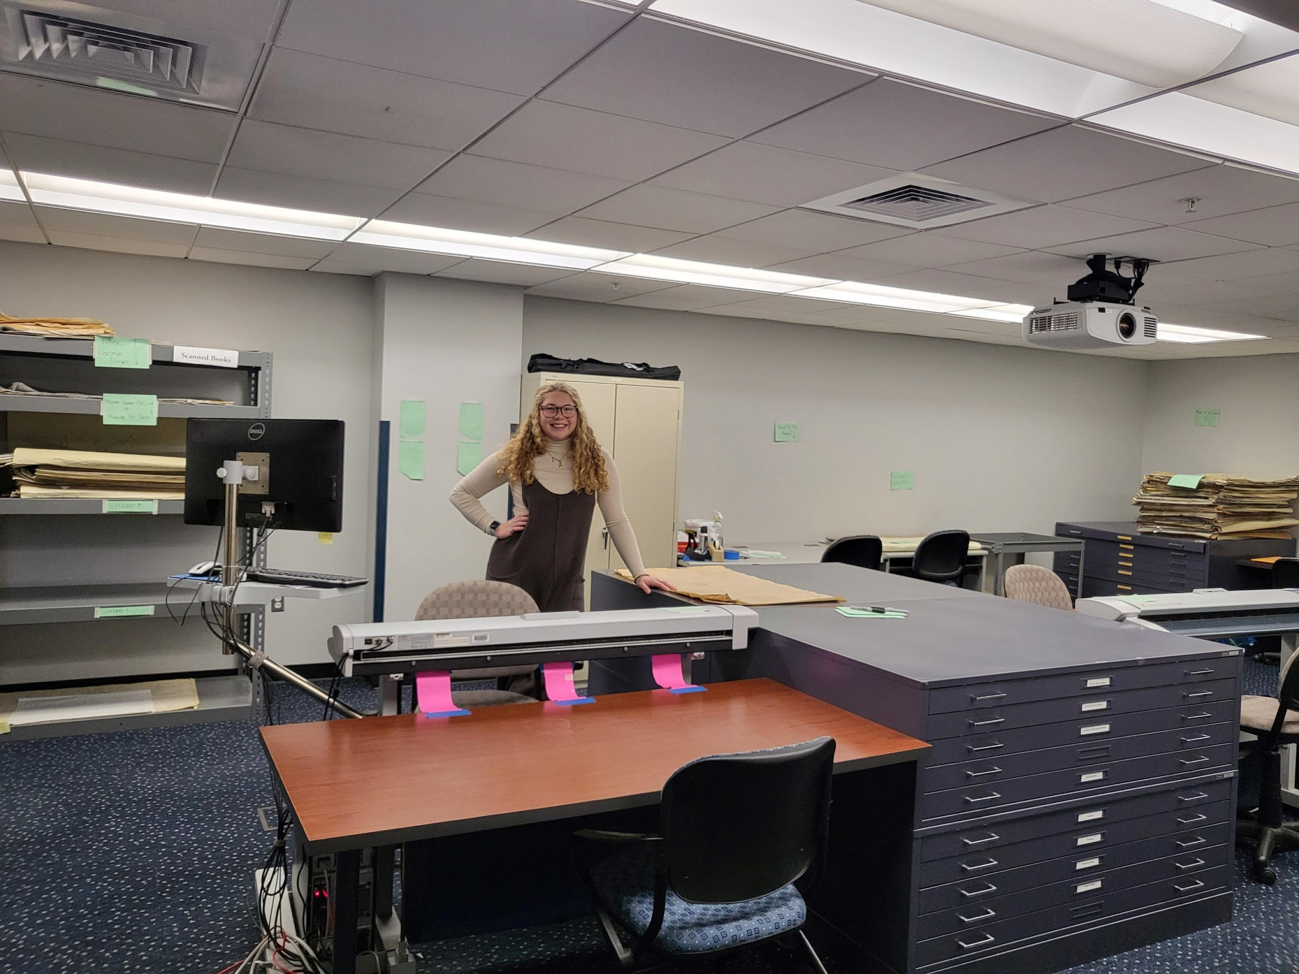
The Tech Center’s Scanning Room
Finished Plans
Plans Needing Named
Plans Ready to Scan
Scanning Stations

Slide 15
Image Processing
Straighten TIFFs
Auto Contrast TIFFs
Each page is straightened to align text for text recognition.
Each page is contrasted for best quality.
Crop TIFFs
Relocate
Each page is cropped to reduce white space and scanner background.
The processed TIFFs are uploaded to the Network.

Slide 16
Building the PDF
04
TIFFs are combined into a single document.
The PDF is relocated to the network drive.
01
03
Text Recognition is performed on the document.
02
The final product is checked for errors and compressed.

Slide 17
Georeferencing
The location of the plan is found on the map.
The GeoTIFF is exported and named.
Plan Location
GeoTIFF Exported
Image Selection
Control Points Set
Relocated
Best page is selected to georeference.
Optimal Control Points are set, transforming the image.
The final compressed folder is uploaded to the network.

Slide 18
Quality Control
Check GeoTIFF
The GeoTIFF is checked for accuracy and quality.
Check PDF
File Rename
The PDF is checked for OCR, artifacts, folds and other errors.
Once approved, the file is renamed using the renaming script.
Relocate File
The TIFF folder is checked for accurate quantity.
The file is moved to its final location for complete Project Books.

Slide 19
Publishing
The extracted GeoTIFFs are added to the whole raster mosaic.
The new footprints coordinates are added to the database.
Add Rasters
Update Footprints
Publish GeoTIFFs
Build Footprints
Publish to Website
GeoTIFFs are extracted from their compressed folders.
Using the added rasters, footprint symbology is built for each.
Each plan is toggled to ‘Published’, allowing the website to display them.

Slide 20
Documentation
Three different documents are used for tracking progress:
DOT_Operator Access Database
DOT Performance Tracker Google Sheet
Web QC Status Google Sheet
Each serves a specific goal. The Access database is for statistics, the Performance Tracker for monitoring the stages of processing, and the Web QC Status for assuring plans on the website function correctly.

Slide 21
03
Project Statistics

Slide 22
500,000
Estimated sum of Phase I-III deliverables. 0 sheets remain till reaching the projected end of Phase III.

Slide 23
459,834
Sheets Scanned
12,433
Plans Scanned
12,345
Plans Published

Slide 24
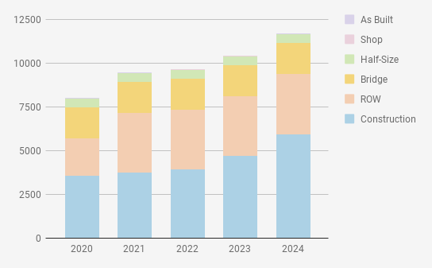
Plan Type Breakdown
Construction Design
Total: 6,671
Right of Way
Total: 3,435
Bridge
Total: 1,787
Half-Size
Total: 497
Shop Drawing
Total Plans as of November 2025:
12,433
Total: 23
As Built
Total: 20

Slide 25
Thank you!
Any questions or feedback?

