Slide 1

STATEWIDE TRANSPORTATION IMPROVEMENT PROGRAM 2027-2032
WV DOT

Slide 2
WV 2027-2032 STIP
AGENDA
01
Introduction to the STIP
02
IIJA vs. FAST ACT
03
2023-2026 STIP Analysis
04
Federal Funding Categories
05
Consideration of the 2027-2032 STIP
06
Closing

Slide 3
WV 2027-2032 STIP
Each state is required under 49 U.S.C. 5304(g) to develop a statewide transportation improvement program (STIP) covering a period of at least four years. The STIP is a staged, multi-year, statewide intermodal program of transportation projects, consistent with the statewide transportation plan and planning processes as well as metropolitan plans, transportation improvement programs (TIPs), and planning processes. The STIP must be developed in cooperation with the metropolitan planning organizations (MPOs), public transit providers, and any Regional Transportation Planning Organizations (RTPO) in the state, and must be compatible with the TIPs for the state's metropolitan areas.
THE STIP

Slide 4
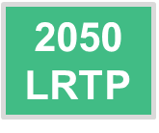
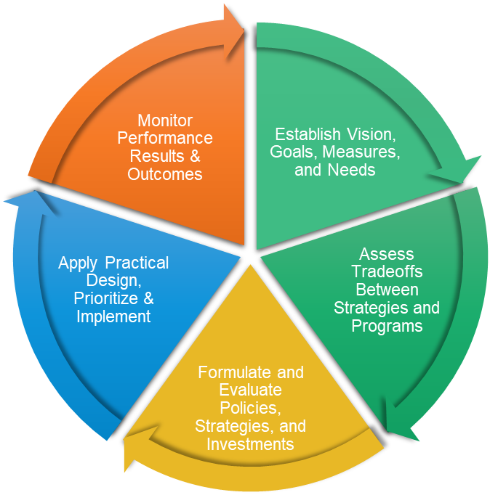
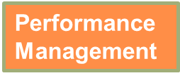

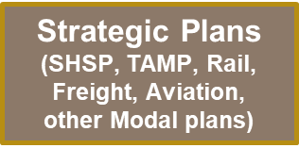
WV 2027-2032 STIP
◈The STIP is a statewide prioritized listing/program of transportation projects covering a period of 4 year that is consistent with:
◈The Long-Range Transportation Plan (LRTP),
◈Metropolitan Transportation Plans (MTPs), and
◈Transportation Improvement Programs (TIPs).
◈The STIP is a Multi-Modal Program
◈Bike, Pedestrian, Transit, etc.
◈The STIP requires transportation projects to be listed to receive eligible federal funding.
◈The STIP is where strategies identified in the plans become real projects

Slide 5
Introduction:
Why now?
We are in the final year of compliance with our current STIP (2023-2028)
Federal obligation requires that the project be included in one of the four constrained years
The final two years of the current STIP are considered as “Information Only”
To meet federal requirements a new STIP must be approved to obligate federal funds
STIP Operating Procedures notes the WVDOT “intends” to update the STIP every 2 years.
The current STIP was Amended throughout the duration to allow for changes for plans, strategies, and needs of the WV DOT.
Many WVDOT Plans and Strategies have been updated or are in the process of updating.
Increased reliance on Data Driven strategies and decisions, such as the Bridge Management System (BMS) & Pavement Management Systems (PMS) have identified needs throughout the state.

Slide 6
WV 2027-2032 STIP
Major Programs
Introduction
The STIP is divided into eight generalized programs based upon a combination of the work being conducted, asset type, and performance measure being addressed. Some projects have characteristics that can qualify the project into multiple programs, however Programming Division assigns to one. For example a roundabout project can qualify for either the Traffic Program or Localized Mobility Improvement Program. If the need for a roundabout was determined out of a safety concern, it would be identified as a Traffic Program Project; If it was to reduce congestion on a section of roadway, it would be classified as a Localized Mobility Improvement Project. Each of the major programs are then broken down into subcategories again based upon type of work and/or route location (Interstate vs State Route).
The eight major programs of the 2027-2032 STIP:
Bridge Program
Pavement Program
Traffic Program
Localized Mobility Program
Community Development & Connectivity Program
Planning And Workforce Development Program
Regional Mobility Program
Transit Program

Slide 7

WV 2027-2032 STIP
Bridge Program: In order for a project to be assigned to this, the bridge must meet the federal definition of a bridge. Bridge program projects usually contain Inspections, Preservation activity, Rehabilitation of the structure, or full Replacement.
Pavement Program: This Program contains projects that help to maintain or improve the State’s Pavement assets. Project activities are classified as Preservation, Rehabilitation, and Reconstruction. Creation of new roadways are excluded from this program.
Traffic Program: The Traffic Program consists of projects that intend to maintain and improve existing signing, lighting, railroad, and traffic signal assets. This also includes initiatives to address spot safety problems that have been identified or have a significant safety element.
Localized Mobility Program: Localized Mobility contains projects to reduce congestion issues, improve air quality, address urban sprawl concerns, as well as roadside safety issues caused by road slips and slides.
Introduction - Major Programs

Slide 8
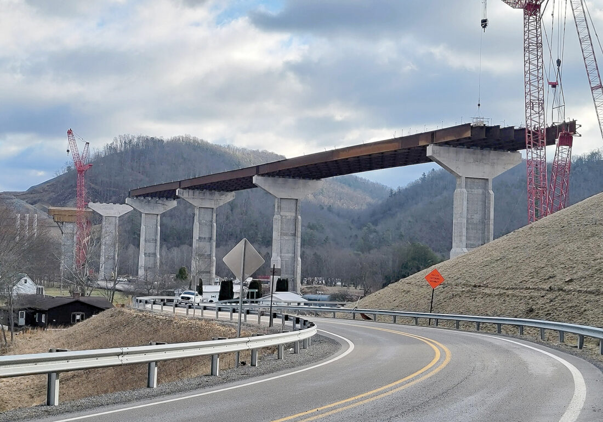
WV 2027-2032 STIP
Community Development & Connectivity Program: The projects associated with this program are comprised of the State’s non traditional grant initiatives (Transportation Alternatives & Recreational Trails) as well as Federal Land Access Program and ADA Ramps. This program aims to advance and/or preserve the State’s Bicycle and Pedestrian infrastructure, as well as motorized/non-motorized trail networks.
Planning & Workforce Development Program: This program covers transportation related research, funding of interagency positions, as well as projects to ensure federal requirements with statewide and metropolitan planning are followed.
Regional Mobility Program: These projects are considered as Regionally Significant and typically contain corridor length expansion and improvement efforts statewide. These aim to serve regional transportation needs, such as access to/from outside the region, major activity centers, or terminals.
Transit Program: The Transit Program covers projects overseen and submitted by West Virginia Division of Multimodal Transportation for approval by FTA. Funding for these initiatives is a combination of federal, state and local sources.
Introduction - Major Programs

Slide 9
WV 2027-2032 STIP
The Infrastructure Investment Jobs Act (IIJA) was enacted in November of 2021 (FFYs 2022 - 2026). It was preceded by the Fixing America’s Surface Transportation (FAST) Act that was enacted and existed between 2016 and 2020 (FFYs 2016-2020). While the FAST Act focused on improving surface transportation, the IIJA expanded on much of FAST Act’s scope.
IIJA VS FAST ACT

Slide 10
WV 2027-2032 STIP
The FAST Act allocated approximately $305 billion focusing on Surface Transportation improvements, while the IIJA allocated $1.2 trillion and included creating new federal aid programs that focused on bridges, electric vehicles, rail, and other programs such as carbon reduction. It also expanded greatly on the competitive discretionary grant program.
Funding Differences

Slide 11
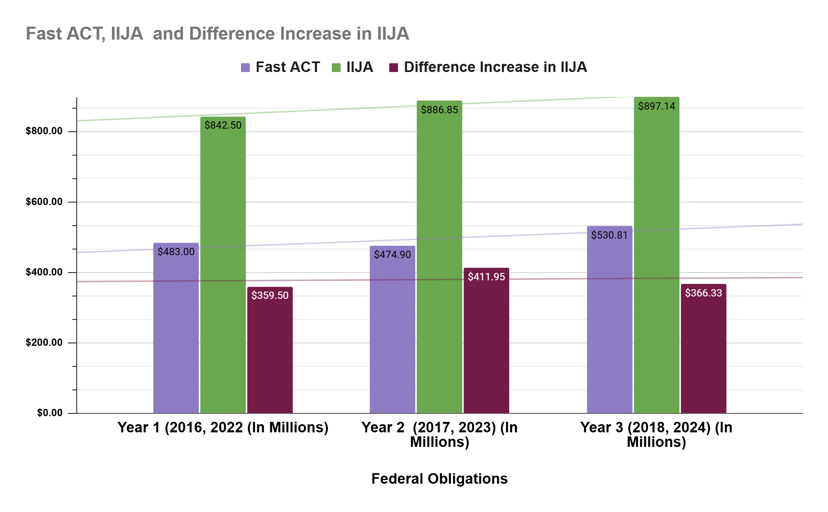
WV 2027-2032 STIP
WV Federal Obligation Review of Fast Act and IIJA Over First Three Years

Slide 12
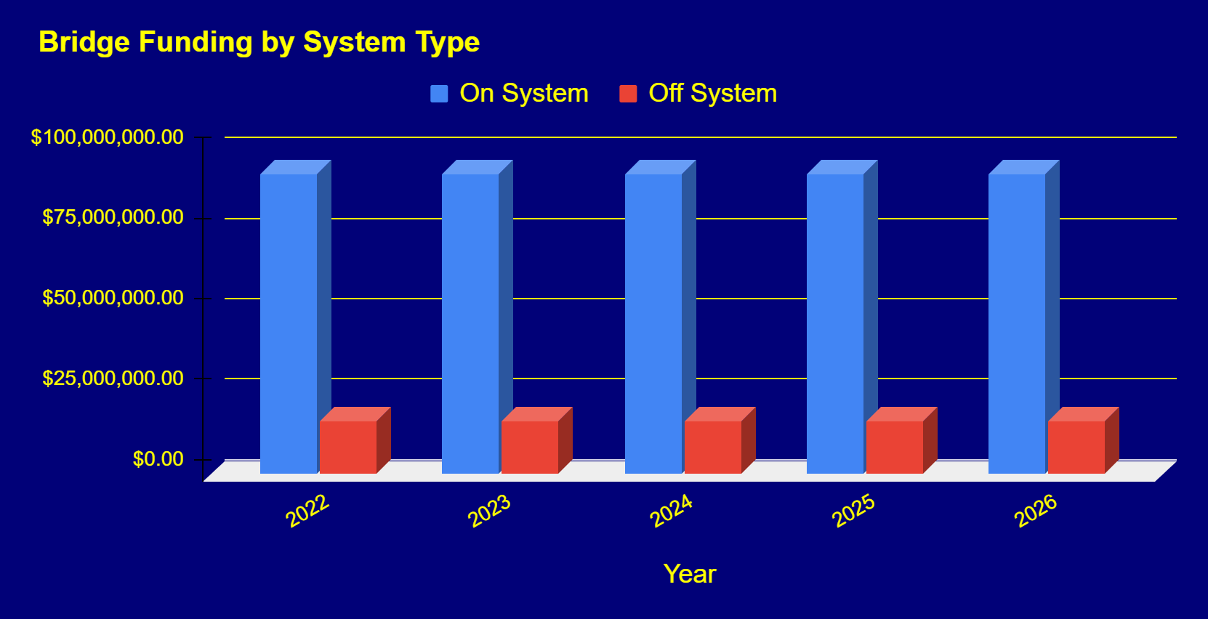
WV 2027-2032 STIP
IIJA set aside 27.5 billion dollars nationally for bridge formula funding. West Virginia received $548 million over the lifespan of IIJA that allocated funds for both on and off system (non federal aid eligible routes).
Bridging the GAP

Slide 13
WV 2027-2032 STIP
2023-2028 STIP OBLIGATION REVIEW
$1.4 Billion obligated to Bridge Improvement Projects.
$775 Million obligated to Pavement Projects.
$485 Million obligated to Traffic Related Projects.
$147 Million obligated to Community Development Projects
$560 Million obligated to Regional Mobility Projects.
$180 Million obligated to Localized Mobility Projects.

Slide 14
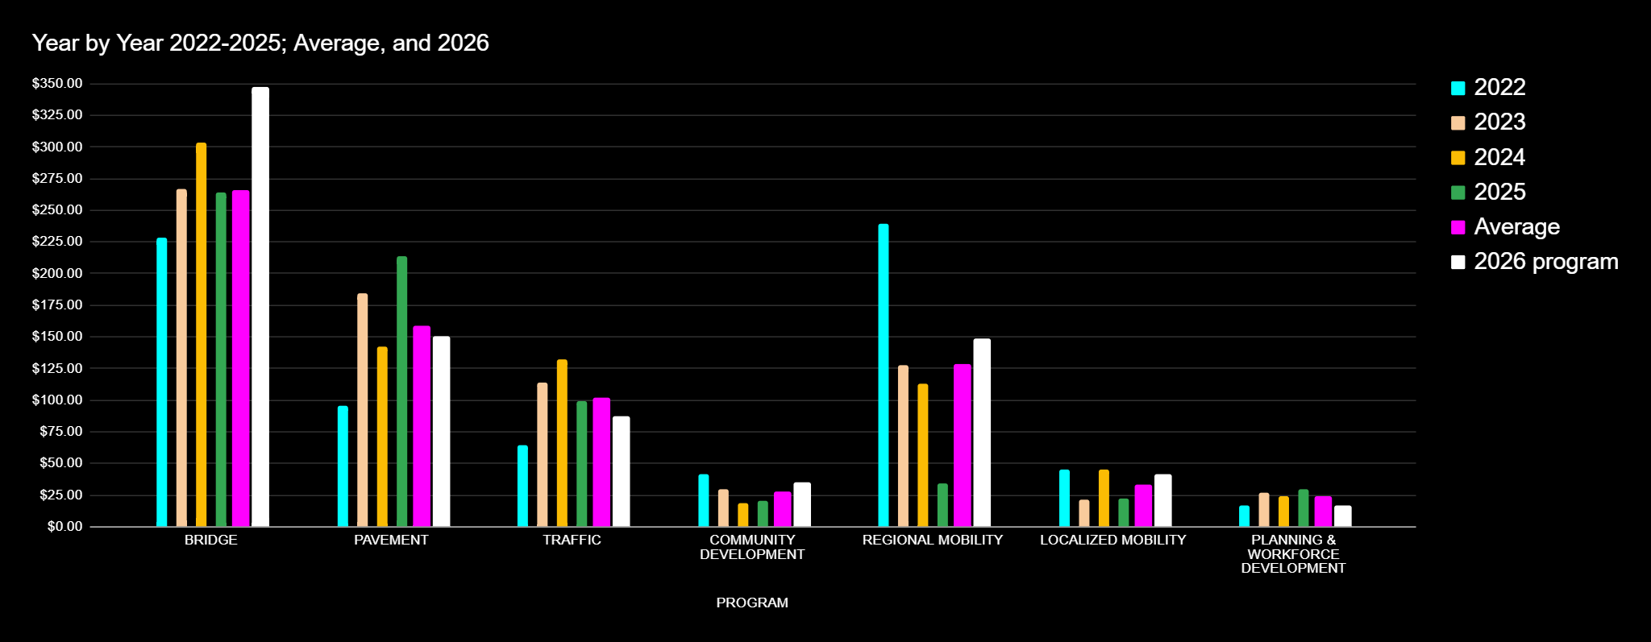
*2026 is currently active year and is based on existing estimates

Slide 15
WV 2027-2032 STIP
Federal funding is broken into different categories (buckets) each with their own respective restrictions and subcategories. Projects can qualify for multiple sources of funding.
HSIP- HIGHWAY SAFETY IMPROVEMENT (Pavement lines-striping, guardrails)
RHCH- RAILWAY HIGHWAY CROSSING /HAZARD ELIMINATION (Railroad crossing upgrades, railroad hazard elimination)
CMAQ/ CRP- CARBON MITIGATION/AIR QUALITY & CARBON REDUCTION PROGRAM (Roundabouts, Signal Timing)
SPR- STATEWIDE PLANNING RESEARCH (US Army Corps of Engineers, Research projects, Metropolitan Planning organization funding)
TAP / NRT – TRANSPORTATION ALTERNATIVE PROJECT / RECREATION TRAILS (Sidewalk improvements, ADA Ramps)
NHFP – NATIONAL HIGHWAY FREIGHT PROGRAM (Improvements on major freight network and reduction of travel time)
NHPP – NATIONAL HIGHWAY PERFORMANCE PROGRAM (Interstate Paving/Bridges, Various Improvements on National Highway System and Corridors)
STBG – SURFACE TRANSPORTATION BLOCK GRANT (NON-NHS Federally eligible route improvements, typically paving and bridge work)
PROT(ECT)- PROMOTING RESILIENT OPERATION FOR TRANSFORMATIVE, EFFICIENT, AND COST SAVING TRANSPORTATION PROGRAM (Projects to address drainage, road slides)
HWI- HIGHWAY INFRASTRUCTURE IMPROVEMENT- (Set aside Bridge Funding, new construction on Corridor H)
NEVI – NATIONAL ELECTRIC VEHICLE INITIATIVE
OTHER – GRANTS, CONGRESSIONAL DIRECTED SPENDING, SPECIFIC ALLOCATED FUNDING
Federal Funding Categories and Examples

Slide 16

WV 2027-2032 STIP
The current funding authorization bill from the federal government– Investment of Infrastructure Jobs Act (IIJA) is in its final year. A new transportation funding authorization bill will be imminent in 2027.
The West Virginia Department of Transportation expects and anticipates funding level changes, which may include new or no longer existing federal aid programs. A new STIP will more than likely be necessary in the near future.
Important Considerations of the 2027-2032 STIP
Fiscal constraint is a key element of the STIP,
meaning we cannot plan to obligate more federal funds than what we have available in any given year, be it through obligation limit or federal aid program. So while there are many needs, we have to plan for the constraint limits.

Slide 17
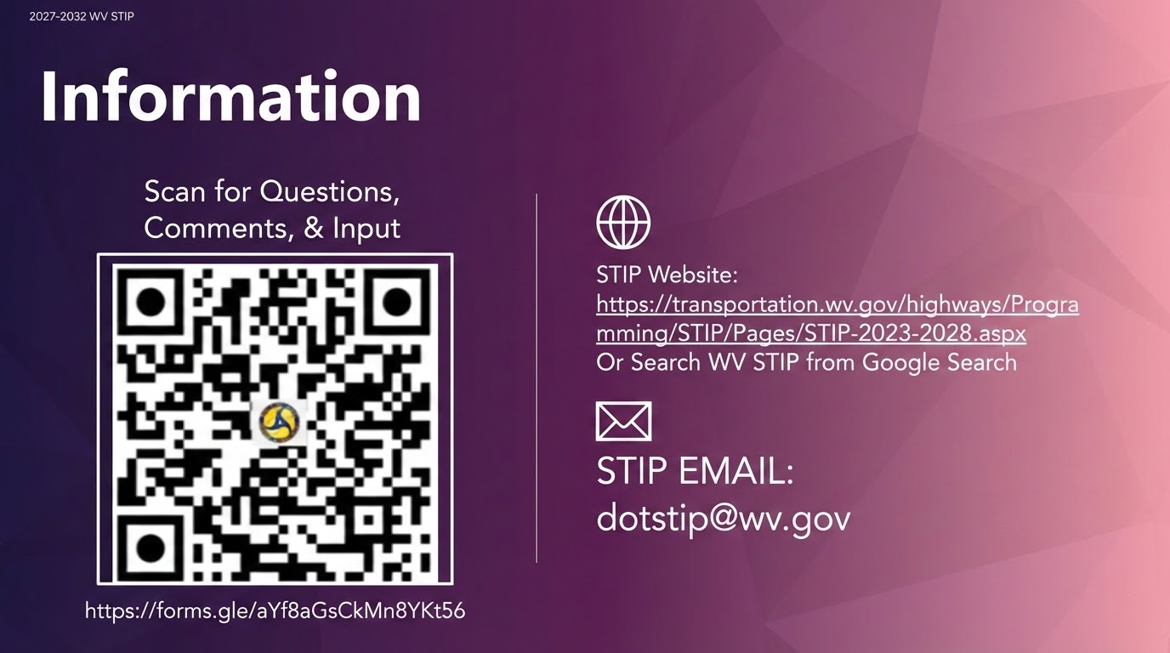

Slide 18
Looking Forward
Transportation Investment Decision Support

Slide 19
Practice Examples
Transportation Investment Decision Support
Statewide & Regional Project Prioritization
Roanoke Needs Prioritization Methodology
Virginia SMART SCALE
GDOT STIP-X
RTC of Southern Nevada Performance-Based Benefits Calculator (PBBC)
Regional Mobility / Corridor Prioritization
Ohio Strategic Transportation & Development Analysis
FDOT Strategic Intermodal System (SIS) Corridors
ARC Appalachian Development Highways Economic Impact Studies
Purpose
Strengthen connection between West Virginia’s Strategic Planning Context and what is funded in the Statewide Transportation Improvement Program.
Foundation
LRTP, TAMP, and modal plans
Output from bridge and pavement management systems
Effective practice examples
Output
A scoring system/tool/framework and documented process for future use

Slide 20
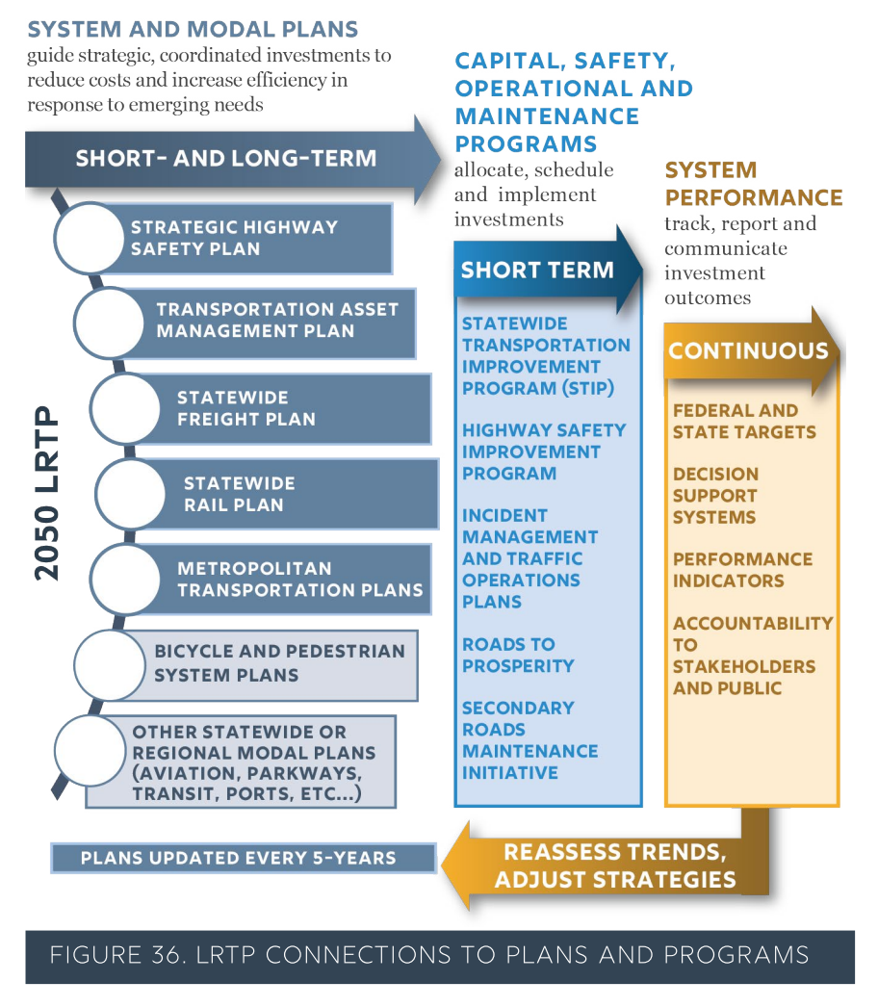
Strategic Planning Context
2050 Long-Range Transportation Plan completed in 2021
Sets strategic priorities, measures
Identifies high-scoring strategies
Most recent Transportation Asset Management Plan (TAMP) in 2022
Sets targets for National Highway System (NHS) pavement/bridge
Discusses financial plan, risks
Defines investment strategies
Updated TAMP due in 2026
Strategic Highway Safety Plan, Freight Plan, others also have investment guidance

Slide 21
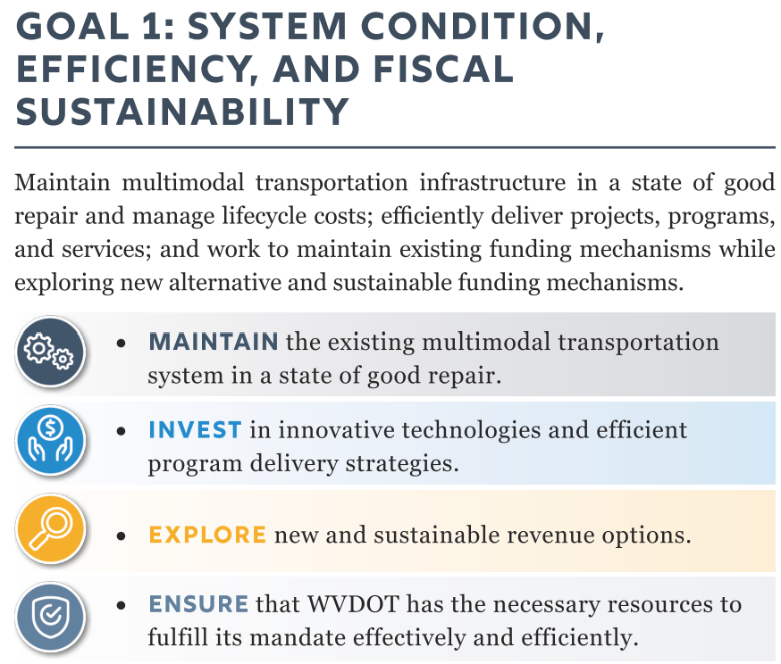
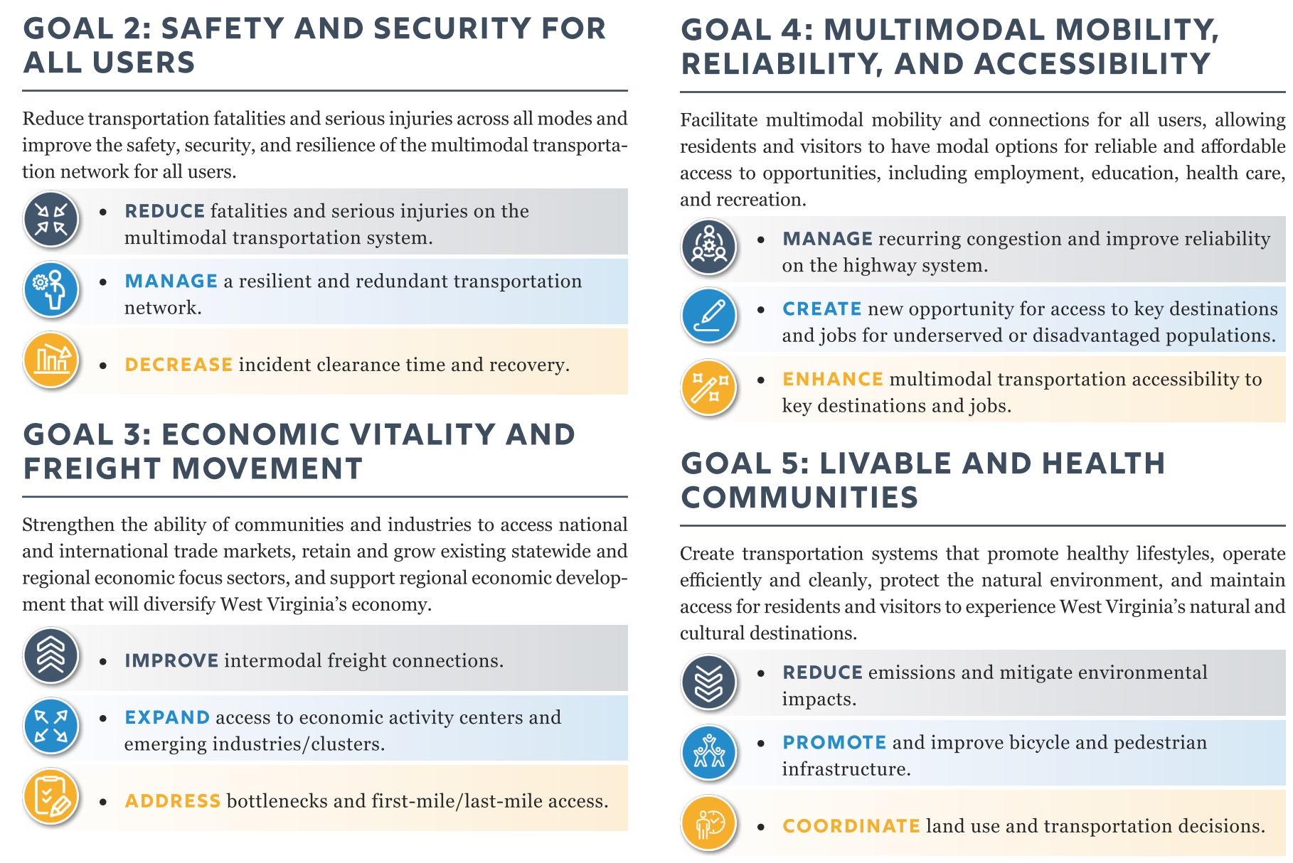
2050 LRTP Goals

Slide 22
2023-2028 WV STIP
Thank You For Everything You Do!
“Coming together is a beginning. Keeping together is progress. Working together is success”- Henry Ford

